Slide 1
Processor Status & FLAGS Register
Course Code: COE 3205
Course Title: Computer Organization & Architecture
Dept. of Computer Science
Faculty of Science and Technology
Lecturer No: | 05 | Week No: | 05 | Semester: | Summer 21-22
Lecturer: | Dr. Md Mehedi Hasan; mmhasan@aiub.edu

Slide 2
Lecture Outline
Overview
Learning Objective
The FLAGS Register
The Status Flags
Overflow
How Instructions Affect the Flags
DEBUG Program

Slide 3
Overview
Computer’s decision-making ability makes it unique than other devices.
The CPU circuits perform decision making based on the processor’s current state.
The 8086 processor’s state is represented with nine individual bits or flags.
The 8086 takes decision based on the flags value.
The flags are placed in the FLAGS register.
Status flags: Reflects the result of computation.
Control flags: used to enable or disable certain operations of processor

Slide 4
Learning Objective
How flags are effected by the machine instructions.
DOS program DEBUG
Display registers, flags and memory locations using DEBUG.

Slide 5
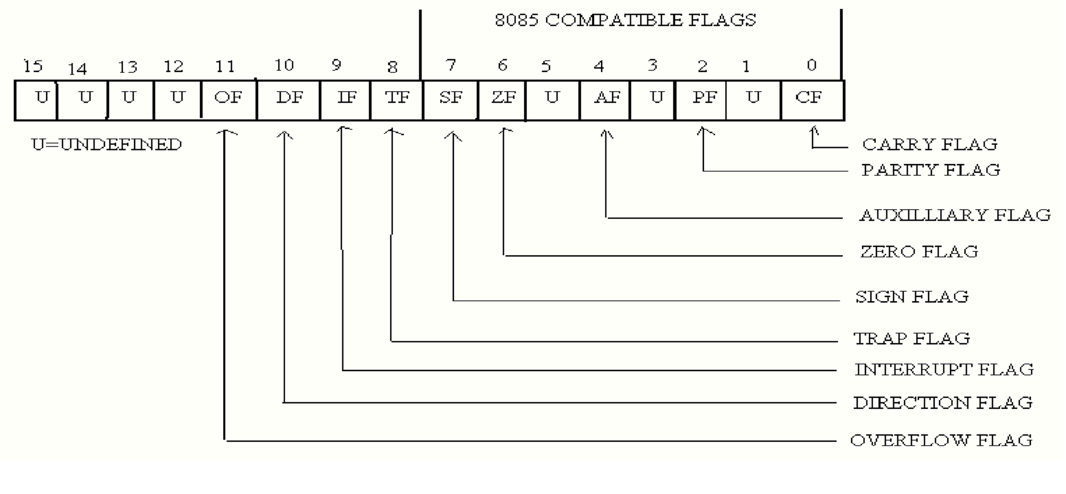
The FLAGS Register
Status Flags: bit 0, 2, 4, 6, 7 and 11
Control Flags: bit 8, 9 and 10
*** bit 1,3,5,12,13,14,15 has no significance

Slide 6
The Status Flags (1/2)
Flags | Descriptions
Carry Flag | CF=1 If there is a carry out from the most significant bit (MSB) on addition. CF=1 If there is a borrow into the most significant bit MSB on subtraction. Otherwise, CF=0
Parity Flag | Even Parity: PF=1, if low byte of a result has even number of one bits [e.g., 1111000011] Odd Parity: PF=0, if low byte of a result has an odd number of one bits [e.g., 1111000111] e.g FFFF is odd parity and FFFE is even parity
Auxiliary carry Flag | AF=1, if there is a carry out from bit 3 on addition or AF=1, if there is a borrow from bit 3 on subtraction.

Slide 7
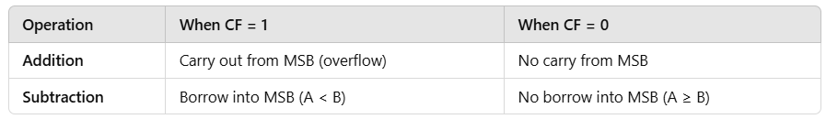
The Status Flags (1/2)
Flags | Descriptions
Carry Flag | CF=1 If there is a carry out from the most significant bit (MSB) on addition. CF=1 If there is a borrow into the most significant bit MSB on subtraction. Otherwise, CF=0
1111 1111 (255 in decimal) + 0000 0001 (1 in decimal) ------------ 1 0000 0000 (256 in decimal — needs 9 bits, carry out occurs) Result = 0000 0000 (only 8 bits stored), and CF = 1

Slide 8
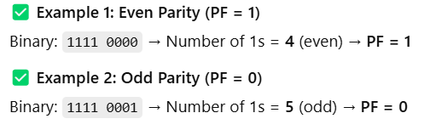

The Status Flags (1/2)
Flags | Descriptions
Parity Flag Even Parity: PF=1, if low byte of a result has even number of one bits [e.g., 1111000011] Odd Parity: PF=0, if low byte of a result has an odd number of one bits [e.g., 1111000111] e.g FFFF is odd parity and FFFE is even parity. The Parity Flag (PF) is a status flag in the CPU that checks if the number of 1s in the lowest byte (8 bits) of a result is even or odd.

Slide 9
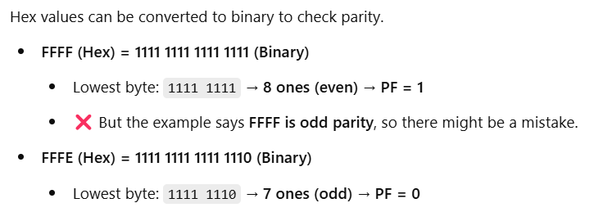
The Status Flags (1/2)
Flags | Descriptions
Parity Flag

Slide 10
The Status Flags (1/2)
Flags | Descriptions
Auxiliary carry Flag AF=1, if there is a carry out from bit 3 on addition or AF=1, if there is a borrow from bit 3 on subtraction. Each bit in an 8-bit binary number is numbered from right to left: Bit: 7 6 5 4 | 3 2 1 0 ↑ ↑ ↑ ↑ ↑ ↑ ↑ ↑ MSB (Most Significant Bit) LSB (Least Significant Bit) The Auxiliary Carry Flag only cares about bit 3 (fourth bit from the right). Addition with Carry from Bit 3. If an addition operation causes a carry from bit 3 (fourth bit) to bit 4 (fifth bit), AF = 1.

Slide 11
The Status Flags (1/2)
Flags | Descriptions
Auxiliary carry Flag 0000 1001 (9 in decimal) + 0000 0111 (7 in decimal) ------------- 0001 0000 (16 in decimal) Carry occurs from bit 3 to bit 4. AF = 1 Subtraction with Borrow from Bit 3. If a subtraction operation requires a borrow at bit 3, AF = 1. 0000 1000 (8 in decimal) -0000 0001 (1 in decimal) ------------- 0000 0111 (7 in decimal) No borrow from bit 3 → AF = 0

Slide 12
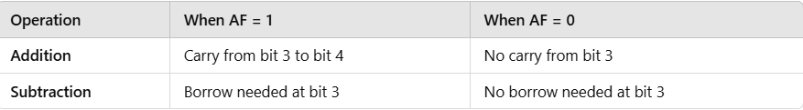
The Status Flags (1/2)
Flags | Descriptions
Auxiliary carry Flag 0000 1000 (8 in decimal) - 0000 1010 (10 in decimal) ------------- 1111 1110 (-2 in two's complement) Borrow required from bit 3 → AF = 1

Slide 13
The Status Flags (2/2)
Zero Flag | ZF=1 for a zero result. e.g. for AX-AX= Zero, thus, ZF=1 ZF=0 for a non-zero result
Example 1: Subtraction Resulting in Zero MOV AX, 5 ; AX = 5 SUB AX, 5 ; AX = AX - 5 → AX = 0 Result = 0, ZF = 1 Example 2: Subtraction Resulting in Non-Zero MOV AX, 7 ; AX = 7 SUB AX, 3 ; AX = AX - 3 → AX = 4 Result = 4, ZF = 0

Slide 14
The Status Flags (2/2)
Zero Flag | ZF=1 for a zero result. e.g. for AX-AX= Zero, thus, ZF=1 ZF=0 for a non-zero result
Example: AND Operation MOV AL, 1010 1010B ; AL = 1010 1010 (Binary) AND AL, 0000 0000B ; Perform bitwise AND with 0000 0000 1010 1010 (AL register) AND 0000 0000 (Operand) --------------- 0000 0000 (Result) Since anything AND 0 is always 0, the final result is 0000 0000 (zero). ✅ Because the result is zero, the Zero Flag (ZF) = 1.

Slide 15
The Status Flags (2/2)
Sign Flag SF=1 if MSB of a result is 1. that is the result is negative SF=0 if the MSB is zero The Sign Flag (SF) is used to determine whether the result of an arithmetic or logical operation is negative or positive in signed binary numbers (two’s complement representation). SF = 1 → The result is negative (MSB = 1). SF = 0 → The result is positive or zero (MSB = 0). Example 1: Positive Result (SF = 0) MOV AL, 0100 1100B ; AL = 4C (Decimal 76) ADD AL, 0000 0010B ; AL = AL + 2 = 78 (0100 1110B) MSB = 0 (Positive), SF = 0 ✅

Slide 16
The Status Flags (2/2)
Sign Flag SF=1 if MSB of a result is 1. that is the result is negative SF=0 if the MSB is zero The Sign Flag (SF) is used to determine whether the result of an arithmetic or logical operation is negative or positive in signed binary numbers (two’s complement representation). SF = 1 → The result is negative (MSB = 1). SF = 0 → The result is positive or zero (MSB = 0). Example 2: Negative Result (SF = 1) MOV AL, 1000 1100B ; AL = 8C (Decimal -116 in two's complement) ADD AL, 0000 0010B ; AL = AL + 2 = 8E (1000 1110B) MSB = 1 (Negative), SF = 1 ✅

Slide 17
The Status Flags (2/2)
Zero Flag | ZF=1 for a zero result. e.g. for AX-AX= Zero, thus, ZF=1 ZF=0 for a non-zero result
Sign Flag | SF=1 if MSB of a result is 1. that is the result is negative SF=0 if the MSB is zero
Overflow Flag | OF=1 if signed overflow occurred otherwise it is 0 (Zero)

Slide 18
Overflow
The range of numbers can be represented is limited!
Range of signed numbers can be represented in 16-bit word is -32768 to 32767
For 8 bit byte it is -128 to 127
For unsigned number, the range for word is 0 to 65535.
For byte it is 0 to 255
If an Operations falls outside these range, overflow occurs and truncated result that is saved and will be incorrect.

Slide 19
Overflow
Possible Overflows
If we perform an arithmetic operation such as addition, there are four possible consequences:
No overflow
Signed overflow only
Unsigned overflows only
Both signed and unsigned overflows

Slide 20
Overflow
Example: Unsigned but not Signed Overflow
AX , FFFFh = 1111111111111111 [-1]
BX , 0001h = 0000000000000001 [+1]
=================
ADD AX,BX 1 0000 0000 0000 0000
For an unsigned interpretation, the correct answer is 10000h or 65536.but this is out of range and 1 is carried out of msb and finally AX= 0000h[WRONG!] thus UNSIGNED overflow occurred.
However, for a signed number the answer is correct FFFFh+0001h or -1+1=0. So no signed overflow occurred.

Slide 21

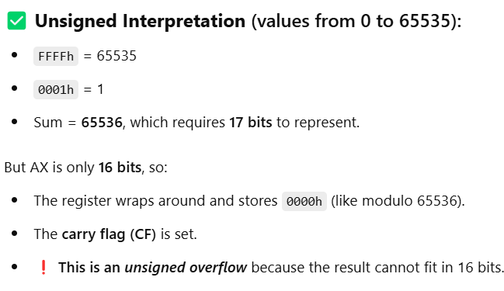
Overflow
Example: Unsigned but not Signed Overflow
1111 1111 1111 1111 (AX = FFFFh)
+ 0000 0000 0000 0001 (BX = 0001h)
---------------------
1 0000 0000 0000 0000 = 10000h
This is a 17-bit result (the leading 1 is a carry out), but the AX register can only hold 16 bits, so the final content of AX becomes:
0000 0000 0000 0000 = 0000h

Slide 22
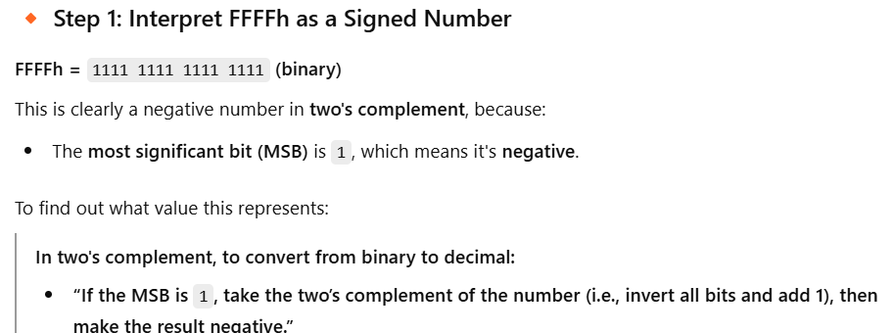
Overflow
Example: Unsigned but not Signed Overflow

Slide 23
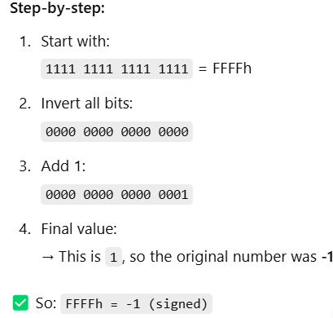
Overflow
Example: Unsigned but not Signed Overflow

Slide 24
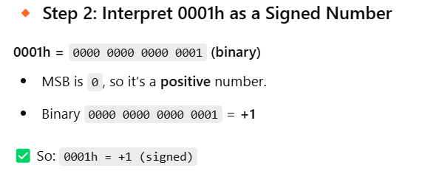
Overflow
Example: Unsigned but not Signed Overflow

Slide 25
Overflow
Example: Unsigned but not Signed Overflow
AX = FFFFh = -1
BX = 0001h = +1
Sum = -1 + 1 = 0
Result in binary: 0000 0000 0000 0000 → 0000hWhich is the correct representation of 0

Slide 26
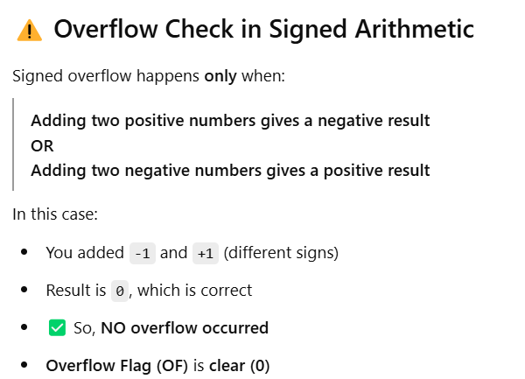
Overflow
Example: Unsigned but not Signed Overflow

Slide 27
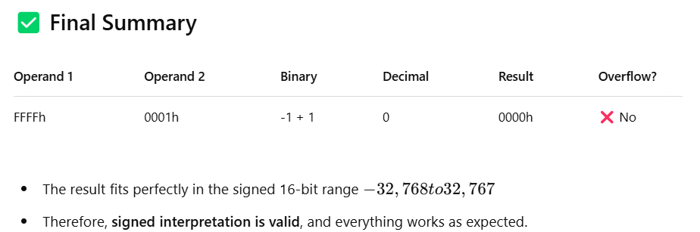
Overflow
Example: Unsigned but not Signed Overflow

Slide 28
Overflow
Example: Signed but not Unsigned Overflow
AX 7FFFh = 0111111111111111
BX 7FFFh = 0111111111111111
=================
ADD AX,BX 1111111111111110 [FFFEh = -2]
For singed and unsigned interpretation, 7FFFh= 32767 thus 7FFFh+7FFFh= 32767+32767 = 65534 [out of range for signed numbers!]. So signed overflow occurred.
However, an unsigned interpretation the answer is correct FFFEh or 65534

Slide 29
Overflow
Processor Overflow Indication
OF = 1 for a signed overflow
CF = 1 for unsigned overflow
Unsigned Overflow:
On addition: the unsigned overflow occurs when there is a carry out of the MSB.
Meaning the correct answer is bigger than largest unsigned number i.e. FFFFh or FFh
On Subtraction: If there is a borrow into the MSB
Meaning the correct answer is Smaller than 0.

Slide 30
Overflow
Signed Overflow:
On addition: On addition with the numbers with the same sign, signed overflow occurs while SUM has different sign.
However, overflow is impossible in addition of numbers with different sign.
On subtraction: Subtraction of numbers with different signs is like adding numbers of the same sign. Signed overflow occurs if the result has different sign than expected.
If there is a carry into msb but no carry out or if there is a carry out but no carry in then the signed overflow occurs and OF is set to 1.

Slide 31
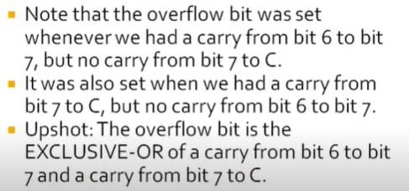
Overflow
Overflow Summary on Addition:

Slide 32
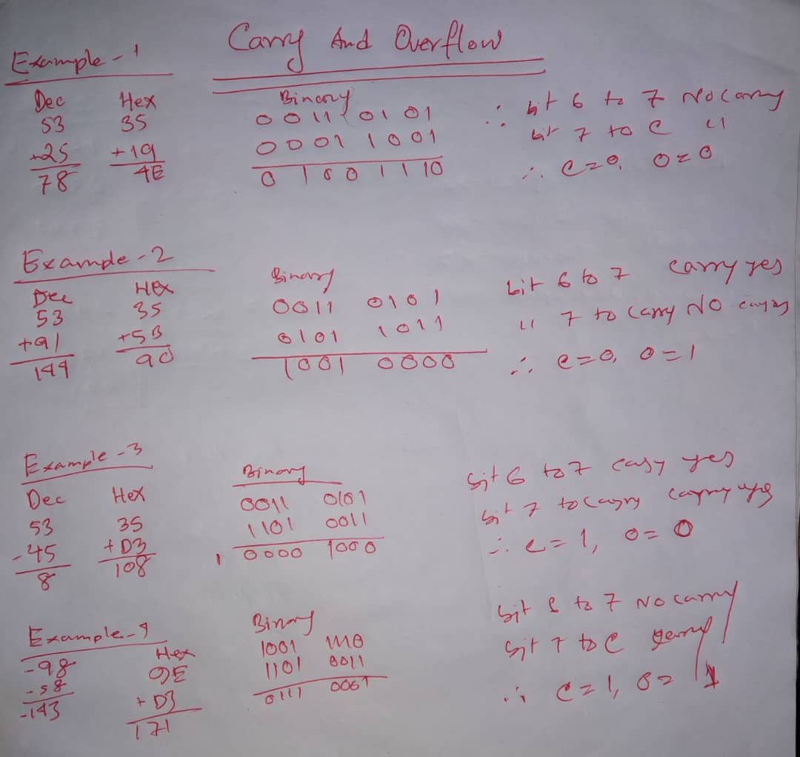
Overflow
Overflow More Examples on Addition:

Slide 33
How Instructions Affect the Flags
INSTRUCTION | AFFECT FLAGS
MOV/ XCHG | NONE
ADD/SUB | ALL
INC/DEC | ALL EXCEPT CARRY FLAG
NEG | ALL(CF =1 UNLESS RESULT 0 OF = 1 IF WORD OPERAND IS 8000H OR BYTE OPERAND IS 80H)

Slide 34
How Instructions Affect the Flags
Examples
ADD AX,BX , WHERE AX CONTAINS FFFFH AND BX CONTAINS FFFFH.
FFFFh
₊ FFFFh
=========
1FFFEh
The result stored in AX is FFFEh = 1111 1111 1111 1110
SF = 1 because msb is 1
PF = 0 because there are 7 of 1 bits in the low byte of the result
ZF = 0 because the result is non zero
CF = 1 because there is a carry out of the msb on addition
OF = 0 because the sign of the stored result is the same as that of the numbers being added( as a binary addition, there is a carry into the msb and also a carry out)

Slide 35
How Instructions Affect the Flags
Examples
ADD AX,BX , WHERE AX CONTAINS FFFFH AND BX CONTAINS FFFFH.
FFFFh
₊ FFFFh
=========
1FFFEh
AX = 1111 1111 1111 1111 (FFFFh, which is -1 in signed)
BX = 1111 1111 1111 1111 (FFFFh, which is -1 in signed)
→ Sum: 1 1111 1111 1111 1110 (1FFFEh → 17 bits!)
Result in AX (16-bit only):AX = 1111 1111 1111 1110 → FFFEh → -2 (signed)

Slide 36
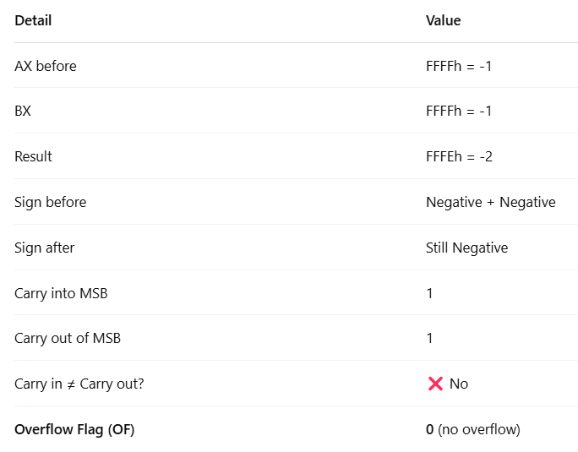
How Instructions Affect the Flags
Examples

Slide 37
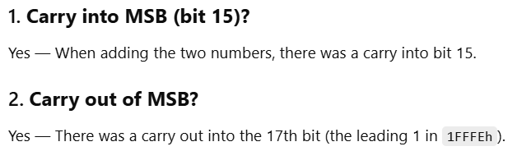
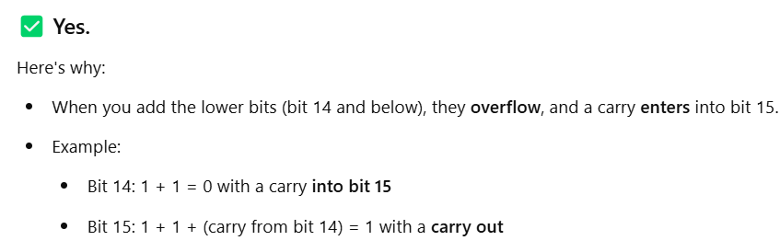
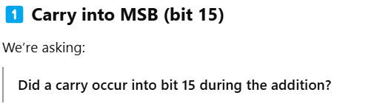
How Instructions Affect the Flags
Examples
Carry into MSB = Carry out of MSB
OF = 0
So when you add FFFFh + FFFFh, you’re adding:
1111 1111 1111 1111
+ 1111 1111 1111 1111
---------------------
1 1111 1111 1111 1110 That gives a 17-bit result.

Slide 38
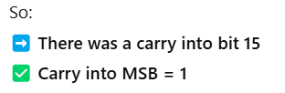
How Instructions Affect the Flags
Examples
Carry into MSB = Carry out of MSB
OF = 0
So when you add FFFFh + FFFFh, you’re adding:
1111 1111 1111 1111
+ 1111 1111 1111 1111
---------------------
1 1111 1111 1111 1110 That gives a 17-bit result.

Slide 39
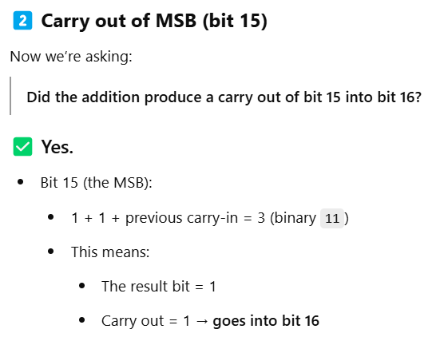
How Instructions Affect the Flags
Examples
Carry into MSB = Carry out of MSB
OF = 0
So when you add FFFFh + FFFFh, you’re adding:
1111 1111 1111 1111
+ 1111 1111 1111 1111
---------------------
1 1111 1111 1111 1110 That gives a 17-bit result.
So the final result is:
1 1111 1111 1111 1110 (bit 16 to bit 0)
↑
carry out (bit 16)

Slide 40
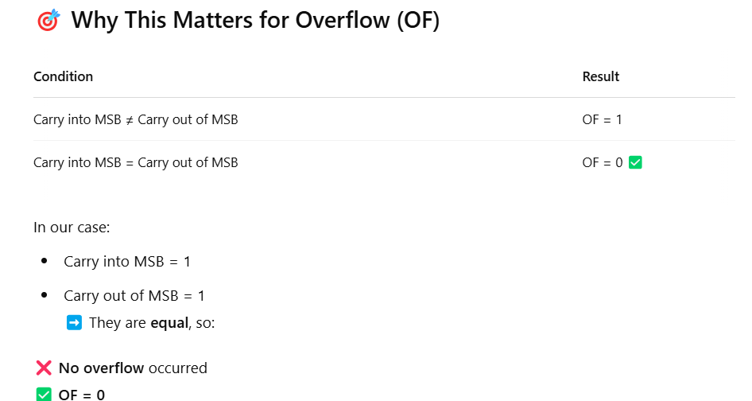
How Instructions Affect the Flags
Examples

Slide 41
How Instructions Affect the Flags
Examples
2. ADD AL, BL ,WHERE AL CONTAINS 80H AND BL CONTAINS 80H.
80h
+ 80h
==========
1 00h
The result stored in AL is 00h.
SF = 0 because the msb is 0
PF = 1 because all the bits in the result are 0
ZF = 1 because the result is 0
CF = 1 because there is a carry out of the msb on the addition
OF = 1 because the numbers being added are both negative, but the result is 0(as a binary addition, there is no carry out into the msb but there is a carry out.)

Slide 42
How Instructions Affect the Flags
Examples
3. NEG AX, WHERE AX CONTAINS 8000H.
8000h = 1000 0000 0000 0000
one’s complement = 0111 1111 1111 1111
two’s complement = + 1
===========================
1000 0000 0000 0000 = 8000h
The result is stored in AX is 8000h
SF = 1
PF = 1
ZF = 0
CF = 1 because for NEG CF is always 1 unless the result is 0
OF = ? because the result is 8000h; when a number is negated , we would expect a sign change, but because 8000h is its own two’s complement , there is no sign change.

Slide 43
HW
Task : Solve the Following and Show the Effects on Flag Registers
SUB AX,BX , WHERE AX CONTAINS 8000H AND BX CONTAINS 0001H.
INC AL, WHERE AL CONTAINS FFH.
MOV AX, -5 .

Slide 44
DEBUGING Program
Debug is used to step through a program, display and change the registers and memory.
It is possible to enter assembly code directly. DEBUG then converts it to machine code and stores it in memory.

Slide 45
DEBUGING Program
Program 1: Checking Flags
.MODEL SMALL
.STACK 100H
.DATA
.CODE
MAIN PROC
MOV AX,4000H ;AX=4000h
ADD AX,AX ;AX=8000h
SUB AX,0FFFFH ;AX=8001h
NEG AX ;AX=7FFFh
INC AX ;AX=8000h
MOV AH,4CH
INT 21H
MAIN ENDP
END MAIN

Slide 46
DEBUGING Program
DEBUG Flag Symbols
Status Flag |  | Set (1) Symbol | Clear (0) Symbol
CF |  | CY (carry) | NC (no carry)
Pf |  | PE (even parity) | PO (odd parity)
AF |  | AC (auxiliary carry) | NA (No Auxiliary carry)
ZF |  | ZR (zero) | NZ (nonzero)
SF |  | NG (negative) | PL (plus)
OF |  | OV (overflow) | NV (no overflow}
Control Flag
DF | DN (down) |  | UP (up)
IF | El (enable interrupts) |  | DI (Disable interrupt)

Slide 47
Books
Assembly Language Programing and Organization of the IBM PC
Ytha Yu
Charles Marut

Slide 48
References
Flag Register Details
https://www.youtube.com/watch?v=-LXc6IvtsfI
https://www.youtube.com/watch?v=vkpGK5bZbSY&list=RDCMUCCU6xxwO9uJuFieylWL2lSA&start_radio=1&t=27
Carry and Overflow Details
https://www.youtube.com/watch?v=9cXe_T99nL4

